Slide 1

Movie Watch List
By Shashank

Slide 2
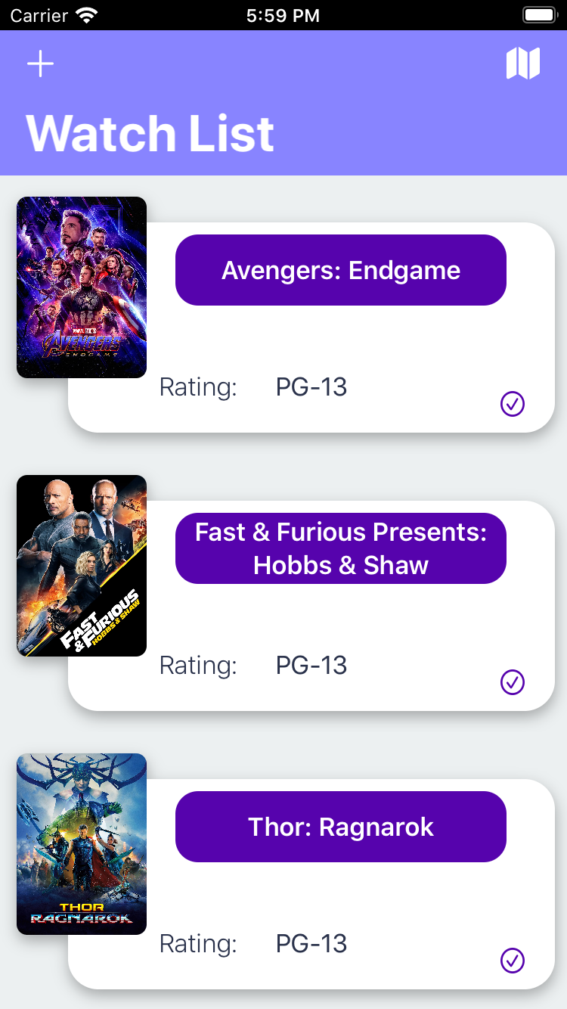
Project Idea
The main Idea of this app is to make a movie watchlist so that when you plan on watching something, it brings up all of the data associated with the movie
Also brings up all of the movie theaters in the area that are near you
Once you finish watching a movie you remove it from the watchlist when you mark it as watched.

Slide 5
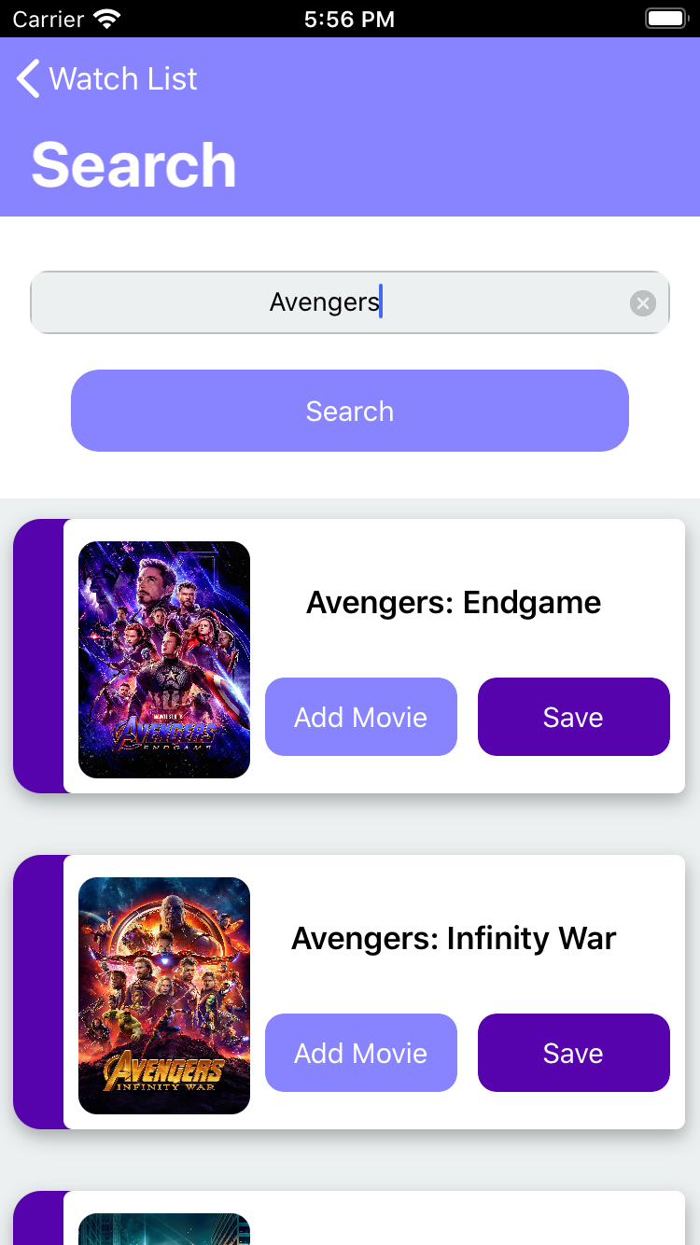
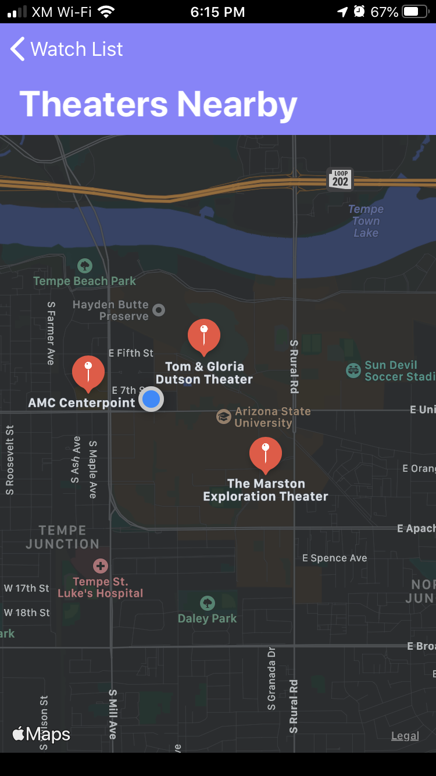
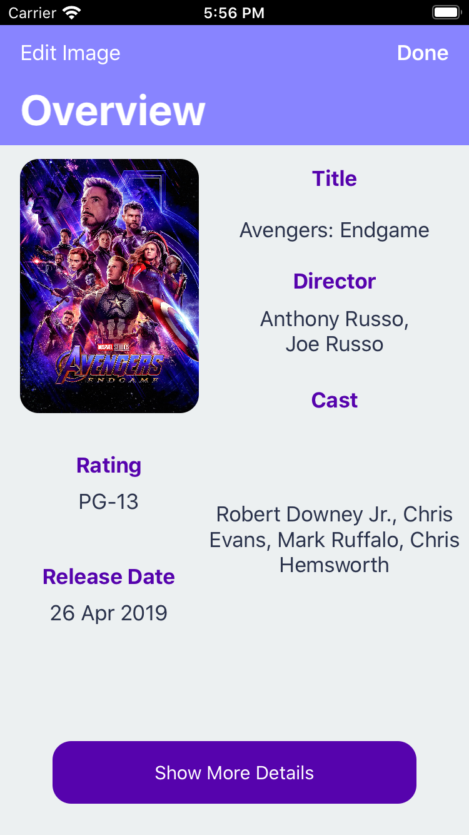
Capabilities
Has the Ability to Search for Movies through a database of movies from a web database of Movies
Fetch Movie posters and data about the movies
Use a secondary api to get data about the movies
Ability to use your own movie poster instead of the one that the API returns
Bring up all of the movie theaters in the area

Slide 6
Limitations
If the movie is in the first API there is a chance that the the movie may not be found when it looks in the second API
When this happens then the Data for the movie may not be available with the exception of the movie poster and the movie title
Some of the other limitations is that there is no way to add a movie that is not on the Database which means that there is no support to add movies that don’t exist on the database.

Slide 7
Lessons Learned
Using Operating Systems Knowledge in order to use Semaphores to halt execution when we are doing JSON Processing
How to Design a Swift UI using UI Views and make the design look different from the stock apple design
Making a Larger Scale swift apps larger than just the labs and having to design how the app will before we actually write the code for it

Slide 8
Suggestions
Lectures On Synchronous and Asynchronous before the project so we know how to make function calls while pausing the UI
Lectures on Using Web API calls in order to fetch images from the internet

